Slide 1
Financial Accounting
Weygandt, Kimmel, Kieso
Eleventh Edition
Chapter 3
Adjusting the Accounts
This slide deck contains animations. Please disable animations if they cause issues with your device.
©2020 John Wiley & Sons, Inc. All rights reserved.

Slide 2

Financial Accounting

Slide 3
Adjusting the Accounts
Learning Objectives
L O 1 Explain the accrual basis of accounting and the reasons for adjusting entries.
L O 2 Prepare adjusting entries for deferrals.
L O 3 Prepare adjusting entries for accruals.
L O 4 Describe the nature and purpose of an adjusted trial balance.

Slide 4
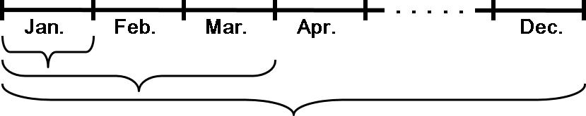
LEARNING OBJECTIVE 1 Explain the Accrual Basis of Accounting and the Reasons for Adjusting Entries
Accountants divide the economic life of a business into artificial time periods (Time Period Assumption).
Generally
a month,
a quarter, or
a year.
Alternative Terminology
The time period assumption is also called the periodicity assumption.
LO 1

Slide 5
Fiscal and Calendar Years
Monthly and quarterly time periods are called interim periods.
Most large companies must prepare both quarterly and annual financial statements.
Fiscal Year = Accounting time period that is one year in length.
Calendar Year = January 1 to December 31.
LO 1

Slide 6
Fiscal and Calendar Years Question
The time period assumption states that:
revenue should be recognized in the accounting period in which it is earned.
expenses should be matched with revenues.
the economic life of a business can be divided into artificial time periods.
the fiscal year should correspond with the calendar year.
LO 1

Slide 7
Fiscal and Calendar Years Answer
The time period assumption states that:
revenue should be recognized in the accounting period in which it is earned.
expenses should be matched with revenues.
Answer: the economic life of a business can be divided into artificial time periods.
the fiscal year should correspond with the calendar year.
LO 1

Slide 8
Accrual-Versus Cash-Basis Accounting Accrual-Basis Accounting
Transactions are recorded in the periods in which the events occur.
Companies recognize revenues when they perform services (rather than when they receive cash).
Expenses are recognized when incurred (rather than when paid).
LO 1

Slide 9
Accrual-Versus Cash-Basis Accounting Cash-Basis Accounting
Revenues are recorded when cash is received.
Expenses are recorded when cash is paid.
Cash-basis accounting is not in accordance with generally accepted accounting principles (GAAP).
LO 1

Slide 10
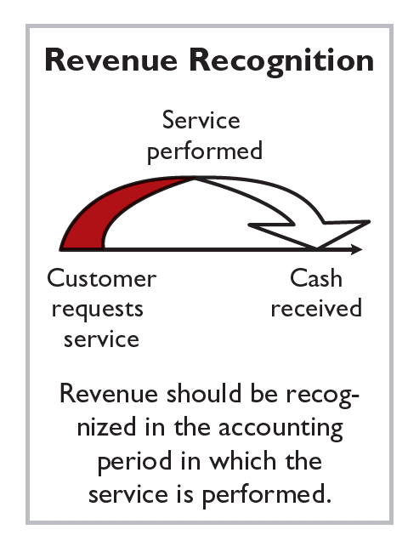
Recognizing Revenues and Expenses Revenue Recognition Principle
Recognize revenue in the accounting period in which the performance obligation is satisfied.
LO 1

Slide 11
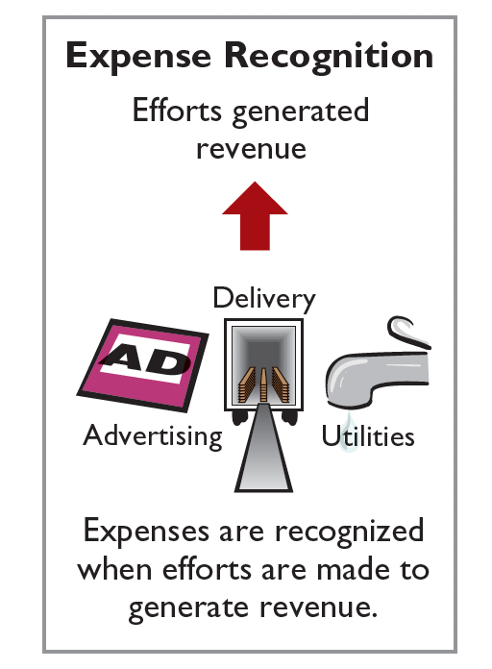
Recognizing Revenues and Expenses Expense Recognition Principle
Match expenses with revenues in the period when the company makes efforts to generate those revenues.
“Let the expenses follow the revenues.”
LO 1

Slide 12
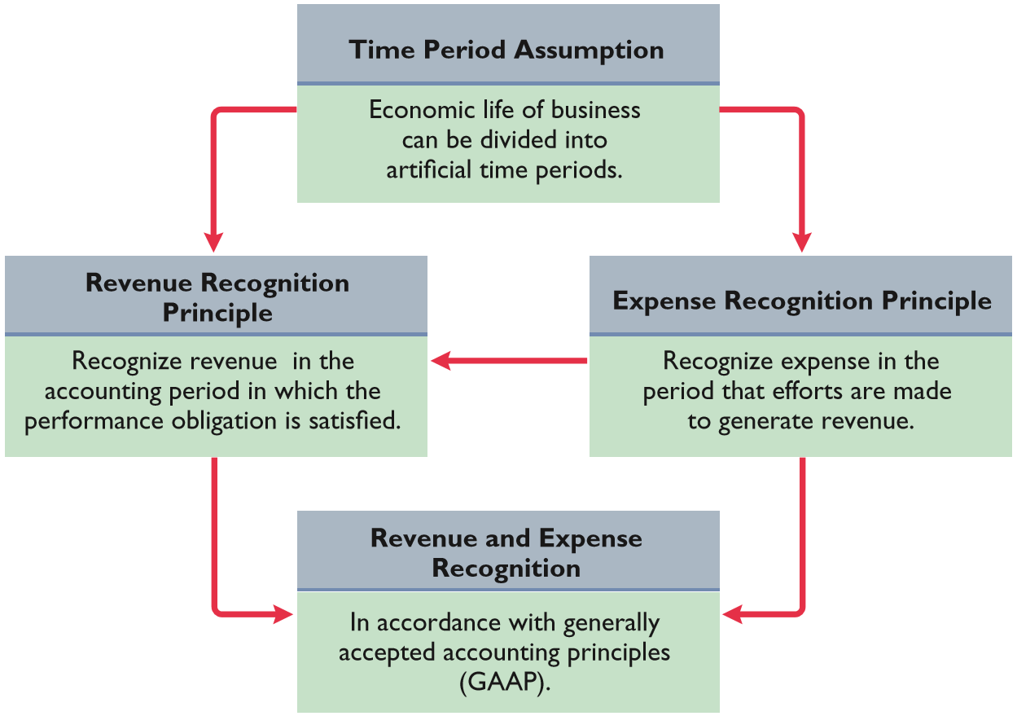
Recognizing Revenues and Expenses Principles and Assumptions
LO 1

Slide 13
Recognizing Revenues and Expenses Question
One of the following statements about the accrual basis of accounting is false. That statement is:
Events that change a company’s financial statements are recorded in the periods in which the events occur.
Revenue is recognized in the period in which the performance obligation is satisfied.
The accrual basis of accounting is in accordance with generally accepted accounting principles.
Revenue is recorded only when cash is received, and expenses are recorded only when cash is paid.
LO 1

Slide 14
Recognizing Revenues and Expenses Answer
One of the following statements about the accrual basis of accounting is false. That statement is:
Events that change a company’s financial statements are recorded in the periods in which the events occur.
Revenue is recognized in the period in which the performance obligation is satisfied.
The accrual basis of accounting is in accordance with generally accepted accounting principles.
Answer: Revenue is recorded only when cash is received, and expenses are recorded only when cash is paid.
LO 1

Slide 15

Investor Insight Apple Inc.
Reporting Revenue Accurately
Until recently, electronics manufacturer Apple was required to spread the revenues from iPhone sales over the two-year period following the sale of the phone. Accounting standards required this because Apple was obligated to provide software updates after the phone was sold. Since Apple had service obligations after the initial date of sale, it was forced to spread the revenue over a two-year period. As a result, the rapid growth of iPhone sales was not fully reflected in the revenue amounts reported in Apple’s income statement. A new accounting standard now enables Apple to report much more of its iPhone revenue at the point of sale. It was estimated that under the new rule, revenues would have been about 17% higher and earnings per share almost 50% higher.
LO 1

Slide 16
Investor Insight Apple Inc. (Question and Answer)
Reporting Revenue Accurately
In the past, why was it argued that Apple should spread the recognition of iPhone revenue over a two-year period, rather than recording it upfront?
Answer:
Apple promises to provide software updates over the life of the phone's use. Because this represents an unfulfilled performance obligation, it was argued that Apple should spread its revenue recognition over a two-year estimated life of the phone.
LO 1

Slide 17
The Need for Adjusting Entries
Adjusting Entries
Ensure that the revenue recognition and expense recognition principles are followed.
Necessary because the trial balance may not contain up-to-date and complete data.
Required every time a company prepares financial statements.
Will include one income statement account and one balance sheet account.
LO 1

Slide 18
The Need for Adjusting Entries Question
Adjusting entries are made to ensure that:
expenses are recognized in the period in which they are incurred.
revenues are recorded in the period in which services are performed.
balance sheet and income statement accounts have correct balances at the end of an accounting period.
all of the above.
LO 1

Slide 19
The Need for Adjusting Entries Answer
Adjusting entries are made to ensure that:
expenses are recognized in the period in which they are incurred.
revenues are recorded in the period in which services are performed.
balance sheet and income statement accounts have correct balances at the end of an accounting period.
Answer: all of the above.
LO 1

Slide 20
Types of Adjusting Entries
Deferrals
Prepaid Expenses: Expenses paid in cash before they are used or consumed.
Unearned Revenues: Cash received before services are performed.
Accruals
Accrued Revenues: Revenues for services performed but not yet received in cash or recorded.
Accrued Expenses: Expenses incurred but not yet paid in cash or recorded.
LO 1

Slide 21
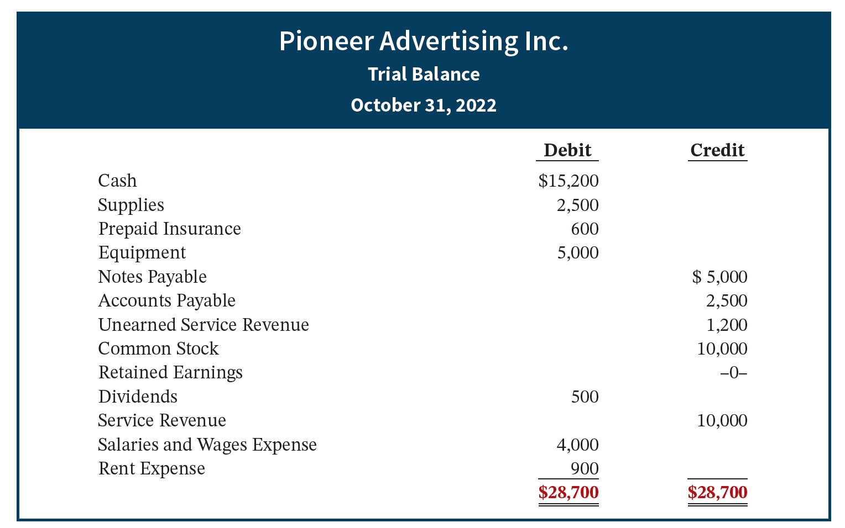
Types of Adjusting Entries Trial Balance
Each account is analyzed to determine whether it is complete and up-to-date for financial statement purposes.
LO 1

Slide 22
DO IT! 1: Timing Concepts
A list of concepts is provided in the left column, with a description of the concept in the right column. There are more descriptions provided than concepts. Match the description of the concept to the concept.
___ Accrual-basis accounting.
___ Calendar year.
___ Time period assumption.
___ Expense recognition principle.
Monthly and quarterly time periods.
Efforts (expenses) should be matched with results (revenues).
Accountants divide the economic life of a business into artificial time periods.
Companies record revenues when they receive cash and record expenses when they pay out cash.
An accounting time period that starts on January 1 and ends on December 31.
Companies record transactions in the period in which the events occur.
LO 1

Slide 23
DO IT! 1: Timing Concepts Solution
A list of concepts is provided in the left column, with a description of the concept in the right column. There are more descriptions provided than concepts. Match the description of the concept to the concept.
f Accrual-basis accounting.
e Calendar year.
c Time period assumption.
b Expense recognition principle.
Monthly and quarterly time periods.
Efforts (expenses) should be matched with results (revenues).
Accountants divide the economic life of a business into artificial time periods.
Companies record revenues when they receive cash and record expenses when they pay out cash.
An accounting time period that starts on January 1 and ends on December 31.
Companies record transactions in the period in which the events occur.
LO 1

Slide 24
LEARNING OBJECTIVE 2 Prepare Adjusting Entries for Deferrals
Deferrals are expenses or revenues that are recognized at a date later than the point when cash was originally exchanged. There are two types:
Prepaid expenses and
Unearned revenues.
LO 2

Slide 25
Prepaid Expenses
Payments of expenses that will benefit more than one accounting period.
Cash Payment | BEFORE | Expense Recorded
Examples of common prepayments are:
Insurance
Supplies
Advertising
Rent
Buildings and equipment
LO 2

Slide 26
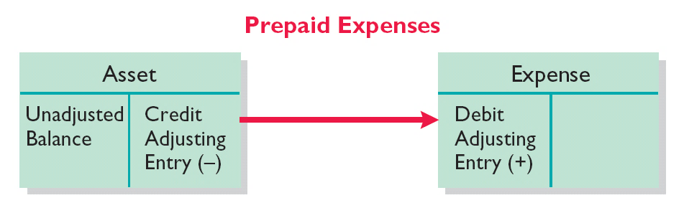
Prepaid Expenses Adjusting entry
Costs that expire either with the passage of time or through use.
Adjusting entry:
Increase (debit) to an expense account and
Decrease (credit) to an asset account.
LO 2

Slide 27
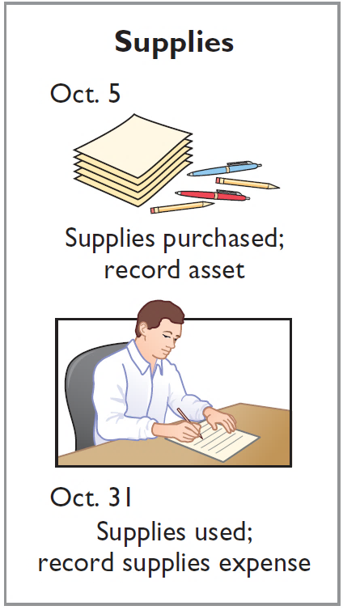
Prepaid Expenses Oct. 31 adjusting entry for supplies used
Pioneer Advertising Inc. purchased supplies costing $2,500 on October 5. Pioneer recorded the purchase by increasing (debiting) the asset Supplies. This account shows a balance of $2,500 in the October 31 trial balance. An inventory count at the close of business on October 31 reveals that $1,000 of supplies are still on hand.
Oct. 31 Supplies Expense 1,500
Supplies 1,500
LO 2

Slide 28
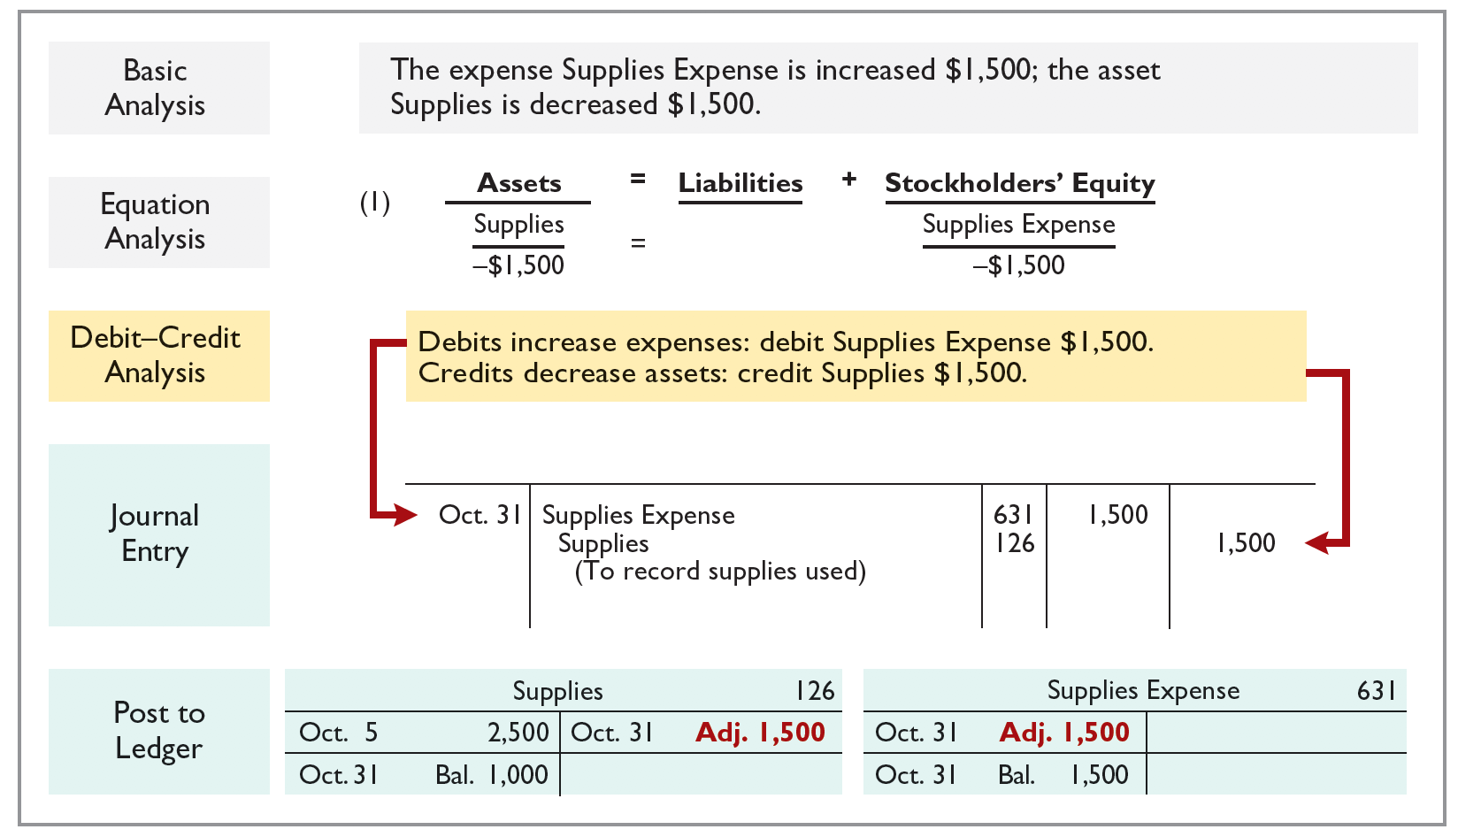
Prepaid Expenses Account balances for Supplies and Supplies Expense
LO 2

Slide 29
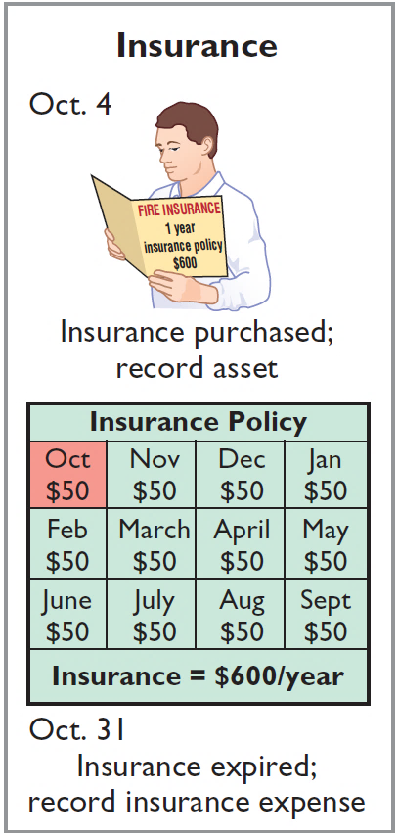
Prepaid Expenses Oct. 31 adjusting entry for insurance expired
Illustration: On October 4, Pioneer Advertising Inc. paid $600 for a one-year fire insurance policy. Coverage began on October 1. Pioneer recorded the payment by increasing (debiting) Prepaid Insurance. This account shows a balance of $600 in the October 31 trial balance. Insurance of $50 ($600 ÷ 12) expires each month.
Oct. 31 Insurance Expense 50
Prepaid Insurance 50
LO 2

Slide 30
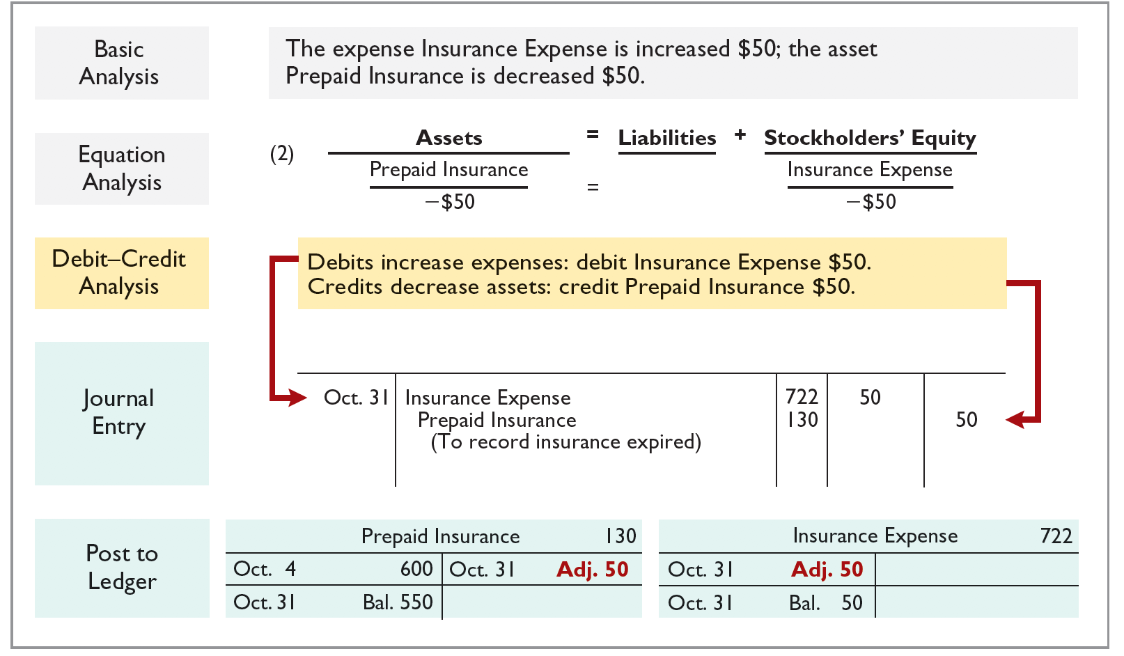
Prepaid Expenses Account balances for Prepaid Insurance and Insurance Expense
LO 2

Slide 31
Prepaid Expenses Depreciation
Buildings, equipment, and motor vehicles (assets that provide service for many years) are recorded as assets, rather than an expense, on the date acquired.
Depreciation is the process of allocating the cost of an asset to expense over its useful life.
Depreciation does not attempt to report the actual change in the value of the asset.
LO 2

Slide 32
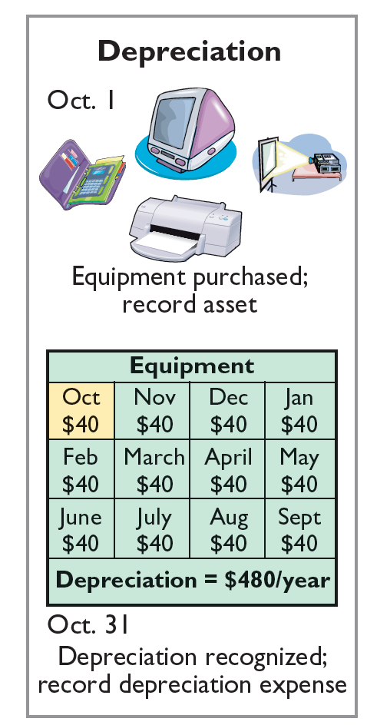
Prepaid Expenses Oct. 31 adjusting entry for depreciation
Illustration: For Pioneer Advertising, assume that depreciation on the equipment is $480 a year, or $40 per month.
Oct. 31 Depreciation Expense 40
Depreciation—Equipment 40
Accumulated Depreciation is called a contra asset account.
Helpful Hint
All contra accounts have increases, decreases, and normal balances opposite to the account to which they relate.
LO 2

Slide 33
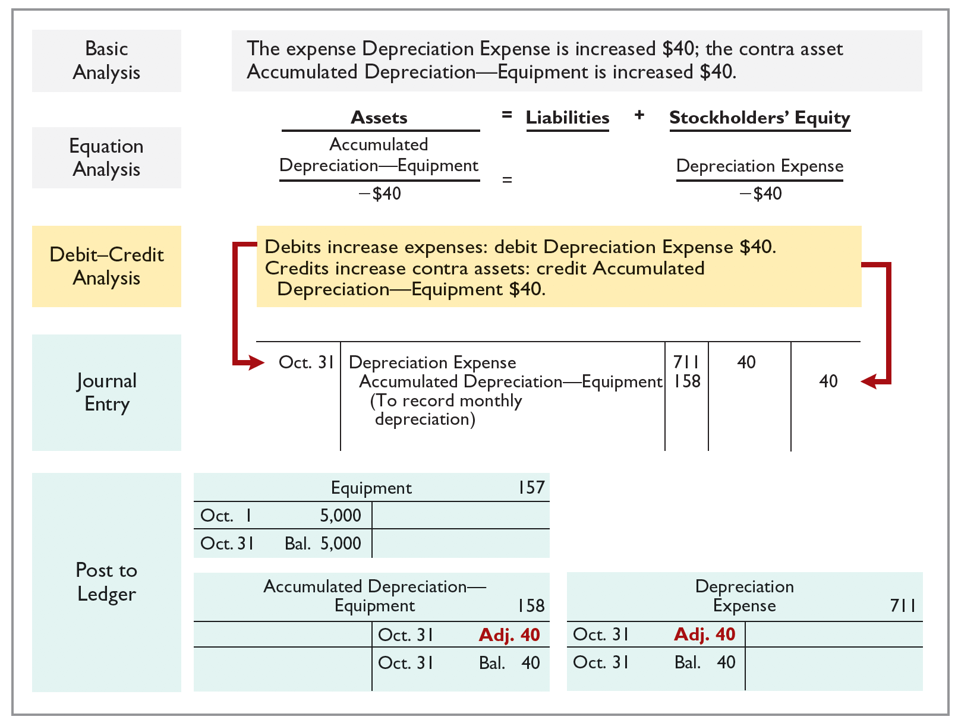
Prepaid Expenses Account balances for Accum. Dep. and Depreciation Expense
LO 2

Slide 34
Prepaid Expenses Statement Presentation
Accumulated Depreciation is a contra asset account (credit).
Appears just after the account it offsets (Equipment) on the balance sheet.
Book value is the difference between the cost of any depreciable asset and its accumulated depreciation.
Equipment | $5,000
Less: Accumulated depreciation–equipment | 40
 | $4,960
LO 2

Slide 35
Prepaid Expenses Accounting for Prepaid Expenses
Examples | Reason for Adjustment | Accounts Before Adjustment | Adjusting Entry
Insurance, supplies, advertising, rent, depreciation | Prepaid expenses originally recorded in asset accounts have been used. | Assets overstated. Expenses understated. | Dr. Expenses Cr. Assets or Contra Assets
LO 2

Slide 36
Unearned Revenues
Receipt of cash that is recorded as a liability because the service has not been performed.
Cash Received | BEFORE | Revenue Earned
Examples of unearned revenues are:
Rent
Airline tickets
Magazine subscriptions
Customer deposits
LO 2

Slide 37
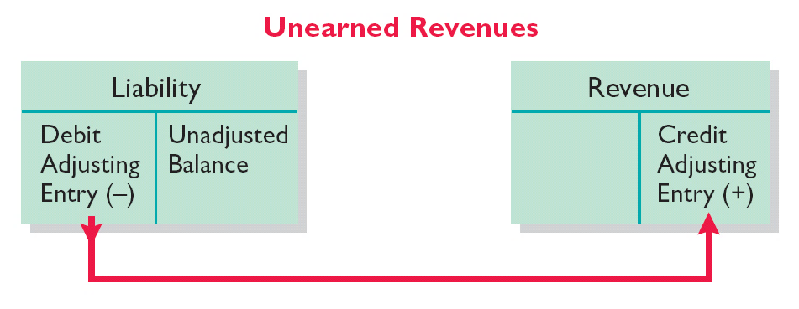
Unearned Revenues Adjusting entry
Adjusting entry is made to record the revenue for services performed during the period and to show the liability that remains at the end of the accounting period.
Results in a decrease (debit) to a liability account and an increase (credit) to a revenue account.
LO 2

Slide 38
Unearned Revenues Oct. 31 adjusting entry for unearned revenue
Illustration: Pioneer Advertising received $1,200 on October 2 from R. Knox for advertising services expected to be completed by December 31. Unearned Service Revenue shows a balance of $1,200 in the October 31 trial balance. Analysis reveals that the company performed $400 of services in October.
Oct. 31 Unearned Service Revenue 400
Service Revenue 400
LO 2

Slide 39
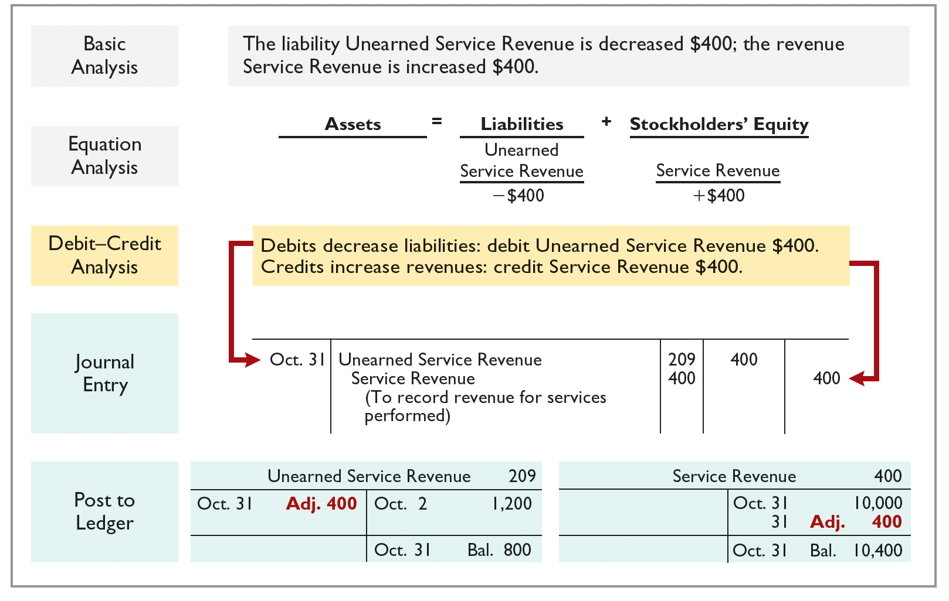
Unearned Revenues Account balances for Unearned Ser. Rev. and Ser. Rev.
LO 2

Slide 40
Unearned Revenues Accounting for Unearned Revenues
Examples | Reason for Adjustment | Accounts Before Adjustment | Adjusting Entry
Rent, magazine subscriptions, customer deposits for future service | Unearned revenues recorded in liability accounts are now recognized as revenue for services performed. | Liabilities overstated. Revenues understated. | Dr. Liabilities Cr. Revenues
LO 2

Slide 41

Accounting Across the Organization: Best Buy
Turning Gift Cards into Revenue
Those of you who are marketing majors (and even most of you who are not) know that gift cards are among the hottest marketing tools in merchandising today. Customers purchase gift cards and give them to someone for later use. In a recent year, gift card sales were expected to exceed $124 billion. Although these programs are popular with marketing executives, they create accounting questions. Should revenue be recorded at the time the gift card is sold, or when it is exercised? How should expired gift cards be accounted for? In a recent balance sheet, Best Buy reported unearned revenue related to gift cards of $427 million. Source: “2014 Gift Card Sales to Top $124 Billion, But Growth Slowing,” PR Newswire (December 10, 2014).
LO 2

Slide 42
Unearned Revenues Question to Ponder
Suppose that Robert Jones purchases a $100 gift card at Best Buy on December 24, 2021, and gives it to his wife, Mary Jones, on December 25, 2021. On January 3, 2022, Mary uses the card to purchase $100 worth of CDs. When do you think Best Buy should recognize revenue and why?
LO 2

Slide 43
Unearned Revenues Answer to Question to Ponder
According to the revenue recognition principle, companies should recognize revenue when the performance obligation is satisfied. In this case, revenue results when Best Buy provides the goods. Thus, when Best Buy receives cash in exchange for the gift card on December 24, 2021, it should recognize a liability, Unearned Sales Revenue, for $100. On January 3, 2022, when Mary Jones exchanges the card for merchandise, Best Buy should recognize revenue and eliminate $100 from the balance in the Unearned Sales Revenue account.
LO 2

Slide 44
Do It! 2: Adjusting Entries for Deferrals Information
The ledger of Hammond Inc., on March 31, 2022, includes these selected accounts before adjusting entries are prepared.
 | Debit | Credit
Prepaid Insurance | $ 3,600
Supplies | 2,800
Equipment | 25,000
Accumulated Depreciation—Equipment |  | $5,000
Unearned Service Revenue |  | 9,200
An analysis of the accounts shows the following.
Insurance expires at the rate of $100 per month.
Supplies on hand total $800.
The equipment depreciates $200 a month.
During March, services were performed for $4,000 of the unearned service revenue.
Prepare the adjusting entries for the month of March.
LO 2

Slide 45
Do It! 2: Adjusting Entries for Deferrals Adjustment for expired insurance
The ledger of Hammond Inc., on March 31, 2022, includes these selected accounts before adjusting entries are prepared.
 | Debit | Credit
Prepaid Insurance | $ 3,600
Supplies | 2,800
Equipment | 25,000
Accumulated Depreciation—Equipment |  | $5,000
Unearned Service Revenue |  | 9,200
Prepare the adjusting entries for the month of March.
Insurance expires at the rate of $100 per month.
Insurance Expense 100
Prepaid Insurance 100
LO 2

Slide 46
Do It! 2: Adjusting Entries for Deferrals Adjustment for used supplies
The ledger of Hammond Inc., on March 31, 2022, includes these selected accounts before adjusting entries are prepared.
 | Debit | Credit
Prepaid Insurance | $ 3,600
Supplies | 2,800
Equipment | 25,000
Accumulated Depreciation—Equipment |  | $5,000
Unearned Service Revenue |  | 9,200
Prepare the adjusting entries for the month of March.
Supplies on hand total $800.
Supplies Expense ($2,800 − $800) 2,000
Supplies 2,000
LO 2

Slide 47
Do It! 2: Adjusting Entries for Deferrals Adjustment for depreciation
The ledger of Hammond Inc., on March 31, 2022, includes these selected accounts before adjusting entries are prepared.
 | Debit | Credit
Prepaid Insurance | $ 3,600
Supplies | 2,800
Equipment | 25,000
Accumulated Depreciation—Equipment |  | $5,000
Unearned Service Revenue |  | 9,200
Prepare the adjusting entries for the month of March.
The equipment depreciates $200 a month.
Depreciation Expense 200
Accumulated Depreciation—Equipment 200
LO 2

Slide 48
Do It! 2: Adjusting Entries for Deferrals Adjustment for unearned revenue
The ledger of Hammond Inc., on March 31, 2022, includes these selected accounts before adjusting entries are prepared.
 | Debit | Credit
Prepaid Insurance | $ 3,600
Supplies | 2,800
Equipment | 25,000
Accumulated Depreciation—Equipment |  | $5,000
Unearned Service Revenue |  | 9,200
Prepare the adjusting entries for the month of March.
During March, services were performed for $4,000 of the unearned service revenue.
Unearned Service Revenue 4,000
Service Revenue 4,000
LO 2

Slide 49
LEARNING OBJECTIVE 3 Prepare Adjusting Entries for Accruals
Accruals are made to record
Revenues for services performed but not yet recorded at the statement date (accrued revenues).
OR
Expenses incurred but not yet paid or recorded at the statement date (accrued expenses).
LO 3

Slide 50
Accrued Revenues
Revenues for services performed but not yet received in cash or recorded.
Service Performed | BEFORE | Cash Received
Examples of accrued revenues are:
Rent
Interest
Services performed
LO 3

Slide 51
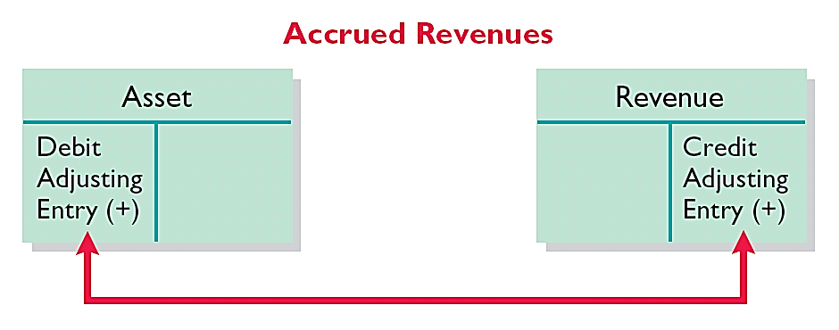
Accrued Revenues Adjusting entry
Adjusting entry records the receivable that exists at the balance sheet date and the revenue for services performed during the period.
Adjusting entry:
Increases (debits) an asset account and
Increases (credits) a revenue account.
LO 3

Slide 52
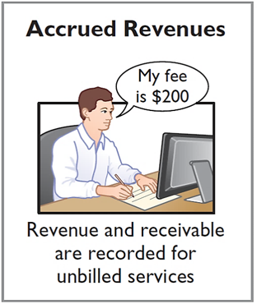
Accrued Revenues Oct. 31 adjusting entry
Illustration: In October, Pioneer Advertising Inc. performed services worth $200 that were not billed to clients in October.
Adjusting entry on Oct. 31 to record accrued revenues.
Oct. 31 Accounts Receivable 200
Service Revenue 200
On November 10, Pioneer receives cash of $200 for the services performed in October.
Nov. 10 Cash 200
Accounts Receivable 200
LO 3

Slide 53
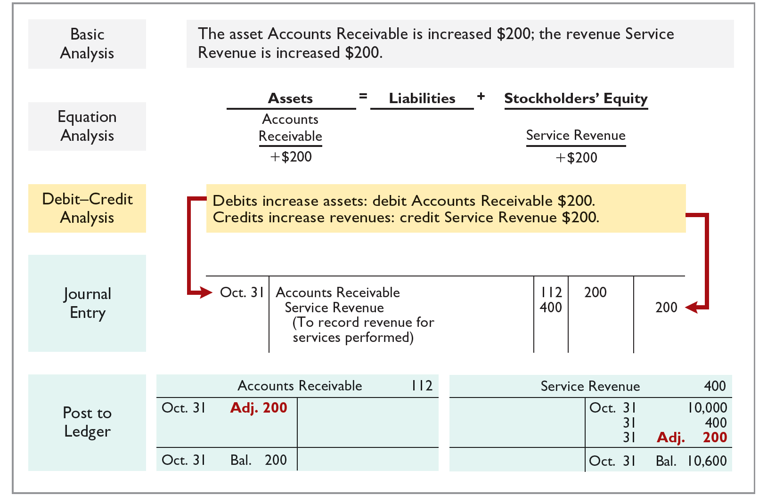
Accrued Revenues Account balances for Acc. Rec. and Service Revenue
LO 3

Slide 54
Accrued Revenues Accounting for Accrued Revenues
Examples | Reason for Adjustment | Accounts Before Adjustment | Adjusting Entry
Interest, rent, services | Services performed but not yet received in cash or recorded. | Assets understated. Revenues understated. | Dr. Assets Cr. Revenues
Ethics Note
A report released by Fannie Mae’s board of directors stated that improper adjusting entries at the mortgage-finance company resulted in delayed recognition of expenses caused by interest rate changes. The motivation for such accounting apparently was the desire to hit earnings estimates.
LO 3

Slide 55
Accrued Expenses
Expenses incurred but not yet paid in cash or recorded.
Expense Recorded | BEFORE | Cash Payment
Examples of accrued expenses are:
Interest
Taxes
Salaries
LO 3

Slide 56
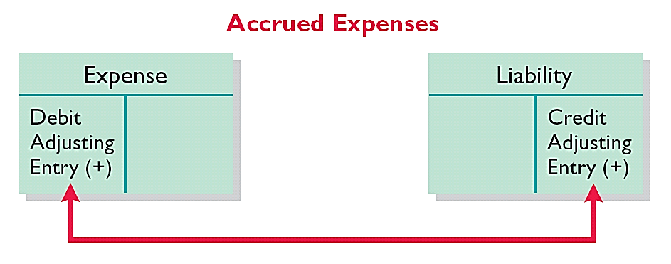
Accrued Expense Adjusting entry
Adjusting entry records the obligation and recognizes the expense.
Adjusting entry:
Increase (debit) an expense account and
Increase (credit) a liability account.
LO 3

Slide 57
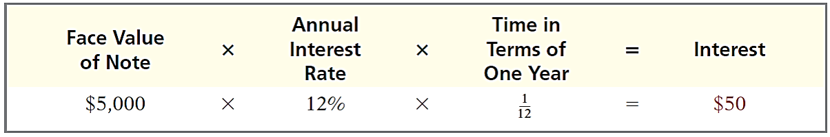
Accrued Expenses Oct. 31 adjusting entry for accrued interest
Illustration: Pioneer Advertising signed a three-month note payable in the amount of $5,000 on October 1. The note requires Pioneer to pay interest at an annual rate of 12%.
Oct. 31 Interest Expense 50
Interest Payable 50
LO 3

Slide 58
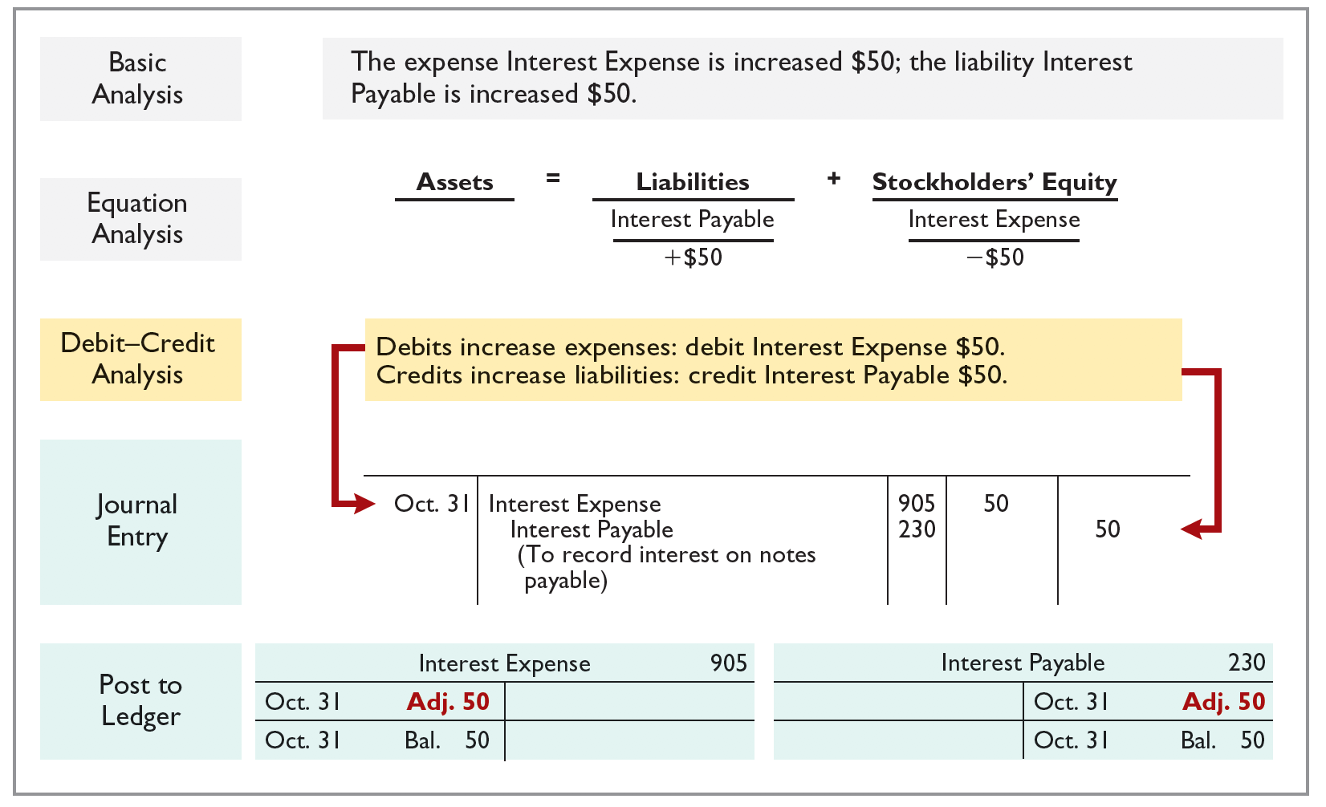
Accrued Expenses Account balances for Interest Expense and Int. Payable
LO 3

Slide 59
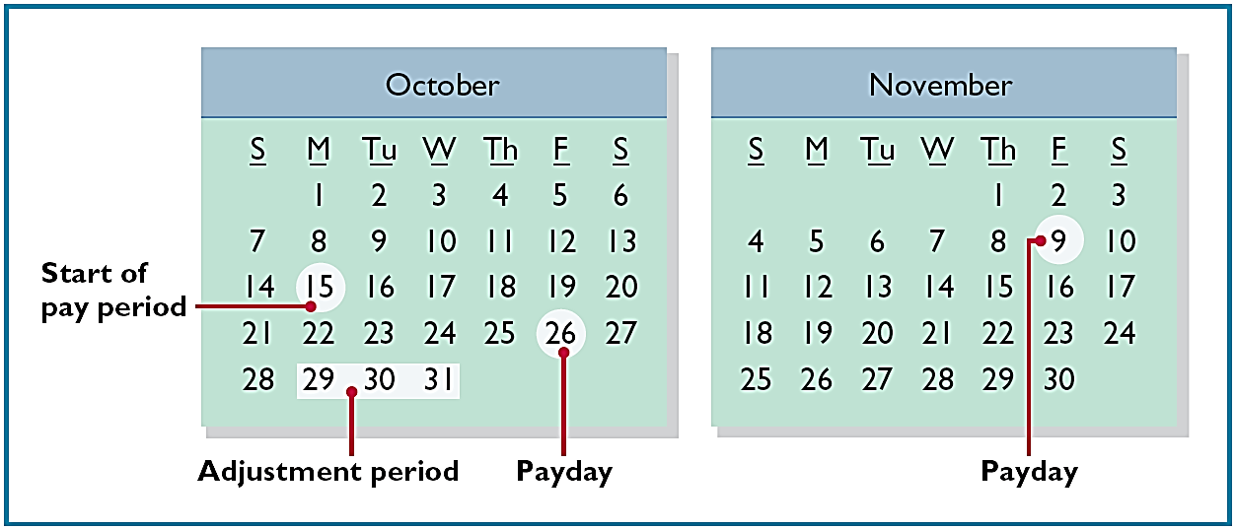
Accrued Expenses Accrued salaries
Illustration: Pioneer paid salaries and wages on October 26 for the first two weeks (October 15-26). The next payment of salaries will not occur until November 9. The employees receive total salaries of $2,000 for a five-day work week, or $400 per day. Thus, accrued salaries at October 31 are $1,200 ($400 × 3 days).
LO 3

Slide 60
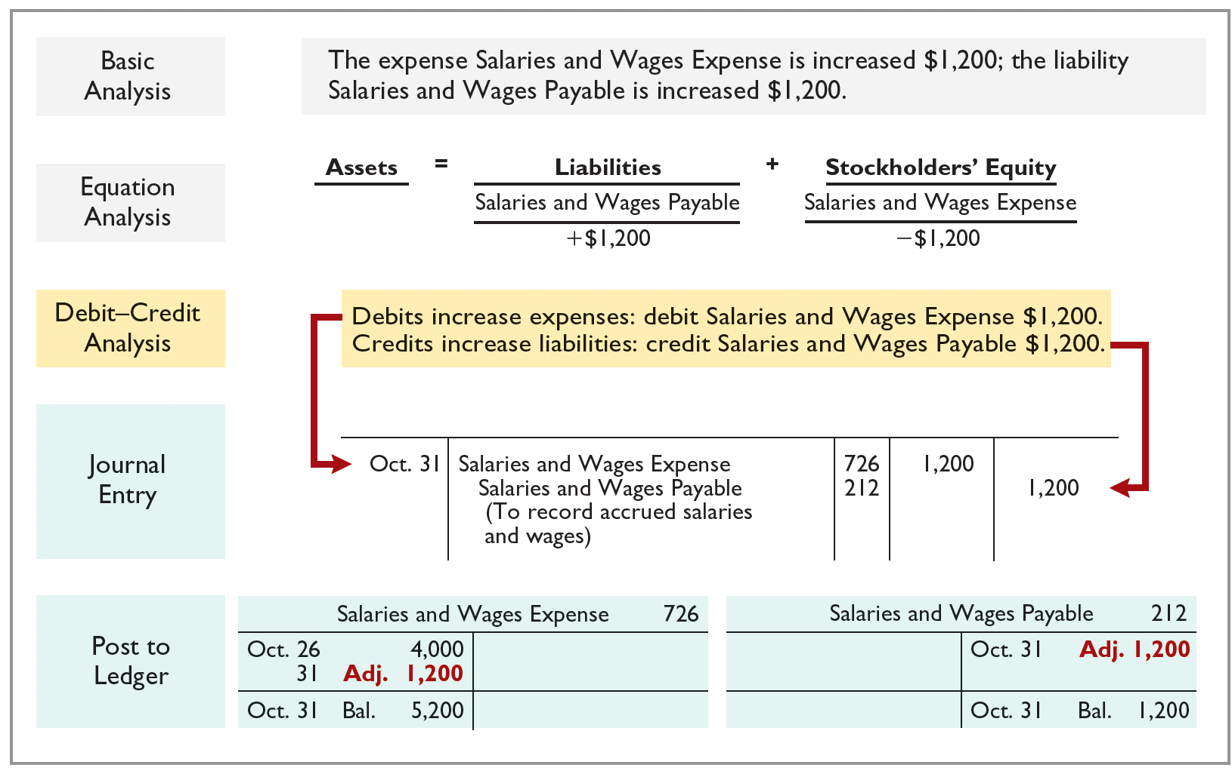
Accrued Expenses Oct. 31 adjusting entry for accrued salaries
LO 3

Slide 61
Accrued Expenses Accounting for Accrued Expenses
Examples | Reason for Adjustment | Accounts Before Adjustment | Adjusting Entry
Interest, rent, salaries | Expenses have been incurred but not yet paid in cash or recorded. | Expenses understated. Liabilities understated. | Dr. Expenses Cr. Liabilities
LO 3

Slide 62

People, Planet, and Profit Insight
Got Junk?
Do you have an old computer or two that you no longer use? How about an old TV that needs replacing? Many people do. Approximately 163,000 computers and televisions become obsolete each day. Yet, in a recent year, only 11% of computers were recycled. It is estimated that 75% of all computers ever sold are sitting in storage somewhere, waiting to be disposed of. Each of these old TVs and computers is loaded with lead, cadmium, mercury, and other toxic chemicals. If you have one of these electronic gadgets, you have a responsibility, and a probable cost, for disposing of it. Companies have the same problem, but their discarded materials may include lead paint, asbestos, and other toxic chemicals.
LO 3

Slide 63
People, Planet, and Profit Insight (Question and Answer)
Got Junk?
What accounting issue might this cause for companies?
Answer:
The balance sheet should provide a fair representation of what a company owns and what it owes. If significant obligations of the company are not reported on the balance sheet, the company's net worth (its equity) will be overstated. While it is true that it is not possible to estimate the exact amount of future environmental cleanup costs, it is becoming clear that companies will be held accountable. Therefore, it seems reasonable to accrue for environmental costs. Recognition of these liabilities provides a more accurate picture of the company's financial position. It also has the potential to improve the environment. As companies are forced to report these amounts on their financial statements, they will start to look for more effective and efficient means to reduce toxic waste and therefore reduce their costs.
LO 3

Slide 64
Summary of Basic Relationships
Type of Adjustment | Accounts Before Adjustment | Adjusting Entry
Prepaid expenses | Assets overstated. Expenses understated. | Dr. Expenses Cr. Assets or Contra Assets
Unearned revenues | Liabilities overstated. Revenues understated. | Dr. Liabilities Cr. Revenues
Accrued revenues | Assets understated. Revenues understated. | Dr. Assets Cr. Revenues
Accrued expenses | Expenses understated. Liabilities understated. | Dr. Expenses Cr. Liabilities
LO 3

Slide 65
DO IT! 3: Adjusting Entries for Accruals Information
Micro Computer Services began operations on August 1, 2022. At the end of August 2022, management prepares monthly financial statements. The following information relates to August.
At August 31, the company owed its employees $800 in salaries and wages that will be paid on September 1.
On August 1, the company borrowed $30,000 from a local bank on a 1-year note payable. The annual interest rate is 10%. Interest will be paid with the note at maturity.
Revenue for services performed but unrecorded for August totaled $1,100.
Prepare the adjusting entries needed at August 31, 2022.
LO 3

Slide 66
DO IT! 3: Adjusting Entries for Accruals Journal entries
Prepare the adjusting entries needed at August 31, 2022.
At August 31, the company owed its employees $800 in salaries and wages that will be paid on September 1.
Salaries and Wages Expense 800
Salaries and Wages Payable 800
On August 1, the company borrowed $30,000 from a local bank on a 1-year note payable. The annual interest rate is 10%. Interest will be paid with the note at maturity.
Interest Expense 250
Interest Payable 250
Revenue for services performed but unrecorded for August totaled $1,100.
Accounts Receivable 1,100
Service Revenue 1,100
LO 3

Slide 67
LEARNING OBJECTIVE 4 Describe the Nature and Purpose of an Adjusted Trial Balance
Preparing the Adjusted Trial Balance
Prepared after all adjusting entries are journalized and posted.
Purpose is to prove the equality of debit balances and credit balances in the ledger after all adjustments.
Is the primary basis for the preparation of financial statements.
LO 4

Slide 68
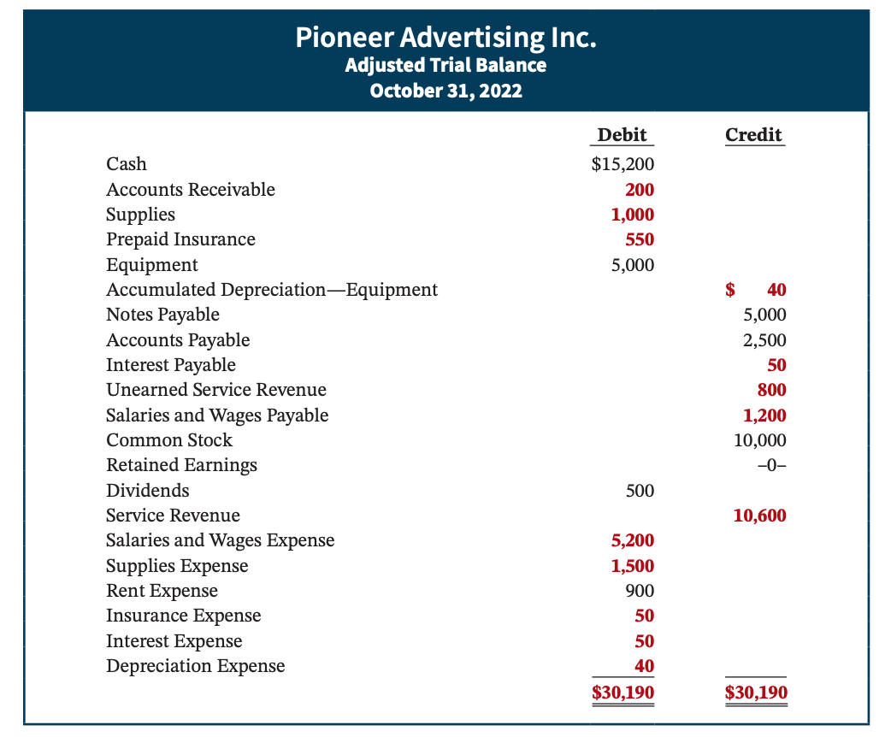
LO 4: Describe the Nature and Purpose of an Adjusted Trial Balance Example
LO 4

Slide 69
The Adjusted Trial Balance Question
Which of the following statements is incorrect concerning the adjusted trial balance?
An adjusted trial balance proves the equality of the total debit balances and the total credit balances in the ledger after all adjustments are made.
The adjusted trial balance provides the primary basis for the preparation of financial statements.
The adjusted trial balance lists the account balances segregated by assets and liabilities.
The adjusted trial balance is prepared after the adjusting entries have been journalized and posted.
LO 4

Slide 70
The Adjusted Trial Balance Answer
Which of the following statements is incorrect concerning the adjusted trial balance?
An adjusted trial balance proves the equality of the total debit balances and the total credit balances in the ledger after all adjustments are made.
The adjusted trial balance provides the primary basis for the preparation of financial statements.
Answer: The adjusted trial balance lists the account balances segregated by assets and liabilities.
The adjusted trial balance is prepared after the adjusting entries have been journalized and posted.
LO 4

Slide 71
Preparing Financial Statements
Financial Statements are prepared directly from the Adjusted Trial Balance.
Income Statement
Retained Earnings Statement
Balance Sheet
LO 4

Slide 72
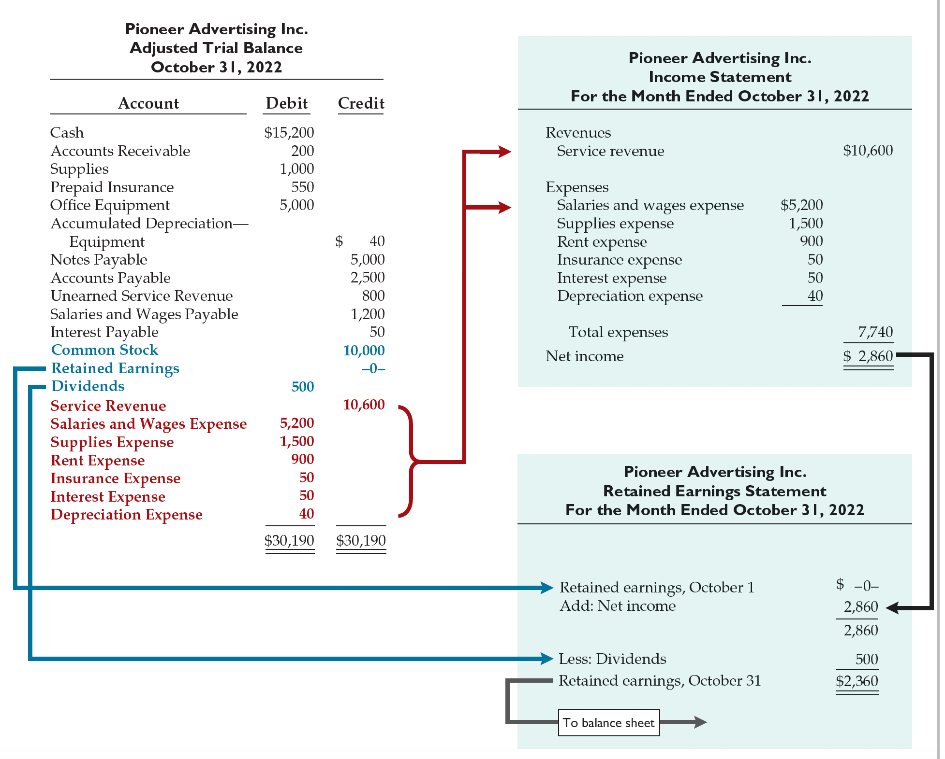
Preparing Financial Statements Income Statement and Retained Earnings Statement
LO 4

Slide 73
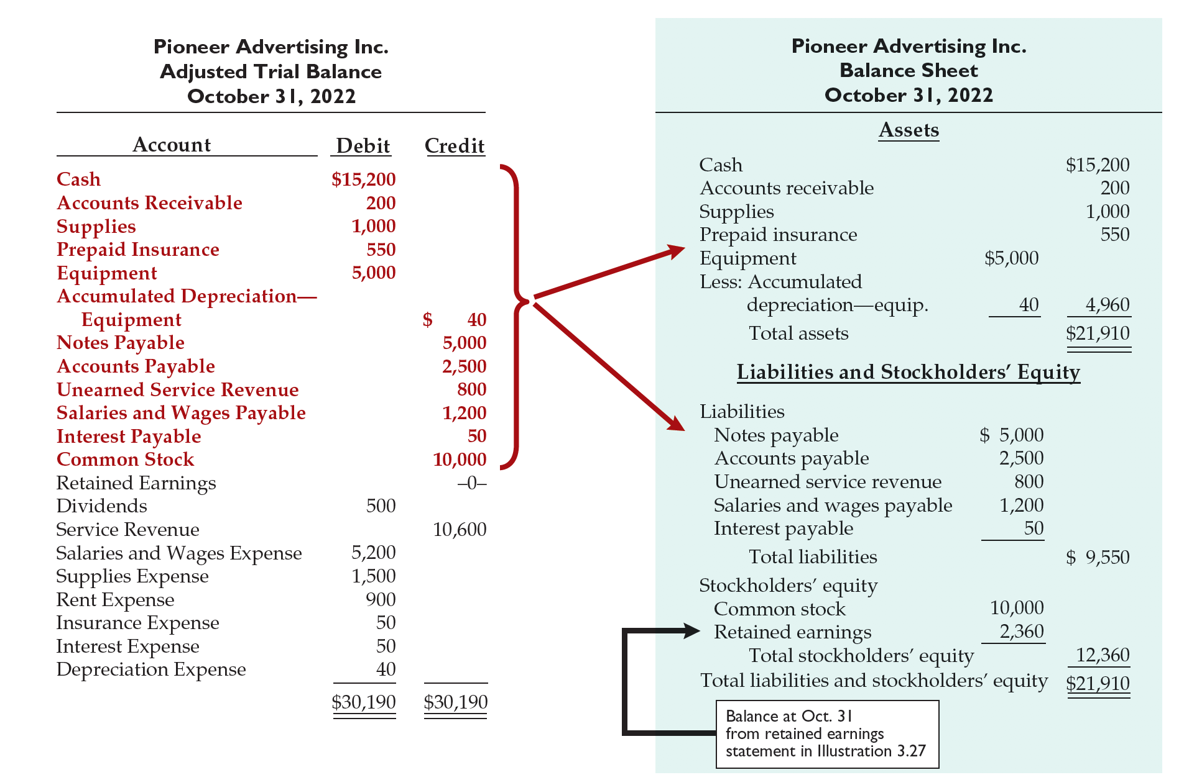
Preparing Financial Statements Balance Sheet
LO 4

Slide 74
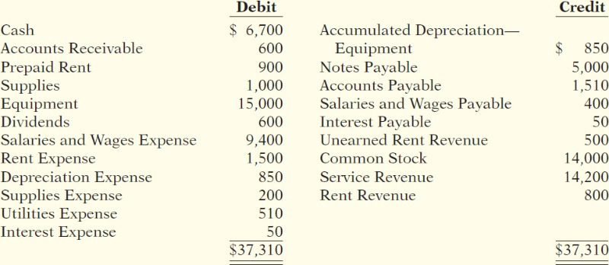
DO IT! 4: Trial Balance Information
Skolnick Co. was organized on April 1, 2022. The company prepares quarterly financial statements. The adjusted trial balance amounts at June 30 are shown below.
Determine the net income for the quarter April 1 to June 30.
Determine the total assets and total liabilities at June 30, 2022, for Skolnick Co.
Determine the amount of retained earnings at June 30, 2022.
LO 4

Slide 75
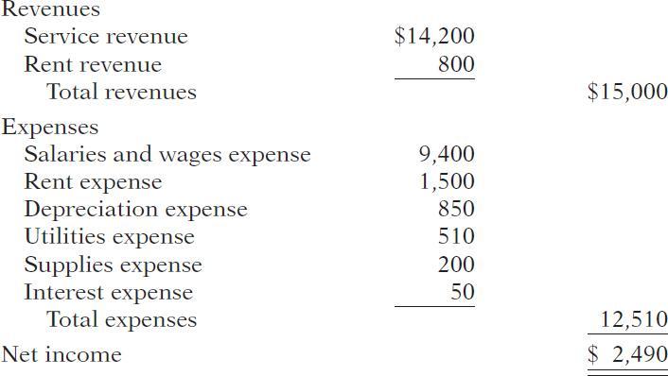
DO IT! 4: Trial Balance Net income solution
The net income is determined by adding revenues and subtracting expenses. The net income is computed as follows:
LO 4

Slide 76
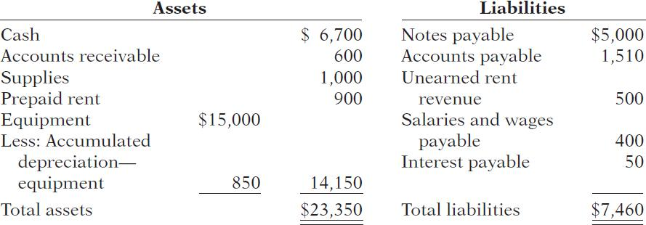
DO IT! 4: Trial Balance Assets and liabilities solution
Total assets and liabilities are computed as follows:
LO 4

Slide 77
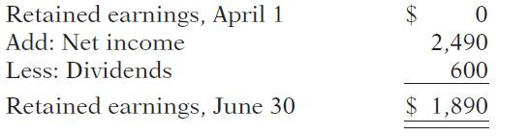
DO IT! 4: Trial Balance Retained earnings solution
Retained earnings is computed as follows:
LO 4

Slide 78
LEARNING OBJECTIVE 5 Appendix 3A: Prepare Adjusting Entries for the Alternative Treatment of Deferrals
Alternate Treatment
When a company prepays an expense, it debits that amount to an expense account.
When it receives payment for future services, it credits the amount to a revenue account.
LO 5

Slide 79
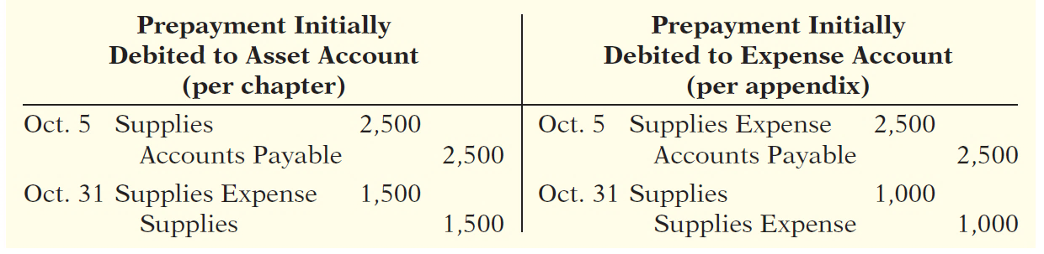
Prepaid Expenses An alternative approach
Companies may choose to debit (increase) an expense account rather than an asset account. This alternative treatment is simply more convenient.
LO 5

Slide 80
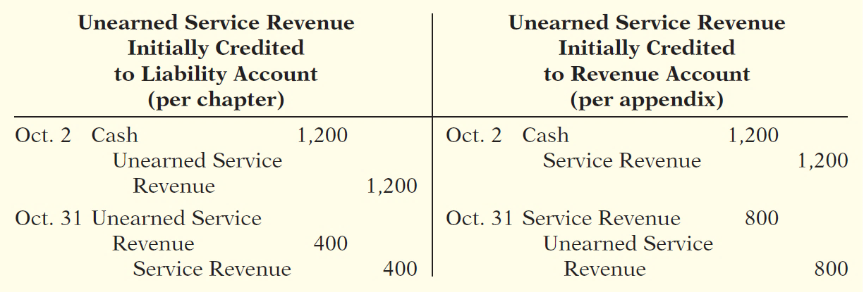
Unearned Revenues An alternative approach
Companies may credit (increase) a revenue account when they receive cash for future services.
LO 5

Slide 81
Summary of Additional Adjustments Relationships
Type of Adjustment | Reason for Adjustment | Account Balances before Adjustment | Adjusting Entry
Prepaid expenses | Prepaid expenses initially recorded in asset accounts have been used. | Assets overstated. Expenses understated. | Dr. Expenses Cr. Assets
 | Prepaid expenses initially recorded in expense accounts have not been used. | Assets understated. Expenses overstated. | Dr. Assets Cr. Expenses
Unearned revenues | Unearned revenues initially recorded in liability accounts are now recognized as revenue. | Liabilities overstated. Revenues understated. | Dr. Liabilities Cr. Revenues
 | Unearned revenues initially recorded in revenue accounts are still unearned. | Liabilities understated. Revenues overstated. | Dr. Revenues Cr. Liabilities
LO 5

Slide 82
LEARNING OBJECTIVE 6 Appendix 3B: Discuss Financial Reporting Concepts
Qualities of Useful Information
Two fundamental qualities, relevance and faithful representation.
Relevance
Make a difference in a business decision.
Provides information that has predictive value and confirmatory value.
Materiality is a company-specific aspect of relevance.
An item is material when its size makes it likely to influence the decision of an investor or creditor.
LO 6

Slide 83
Qualities of Useful Information Fundamental qualities
Two fundamental qualities, relevance and faithful representation.
Faithful Representation
Information accurately depicts what really happened.
Information must be
complete (nothing important has been omitted),
neutral (is not biased toward one position or another), and
free from error.
LO 6

Slide 84
Qualities of Useful Information Enhancing qualities
Comparability results when different companies use the same accounting principles.
Information is verifiable if independent observers, using the same methods, obtain similar results.
Information has the quality of understandability if it is presented in a clear and concise fashion.
Consistency means that a company uses the same accounting principles and methods from year to year.
For accounting information to have relevance, it must be timely.
LO 6

Slide 85
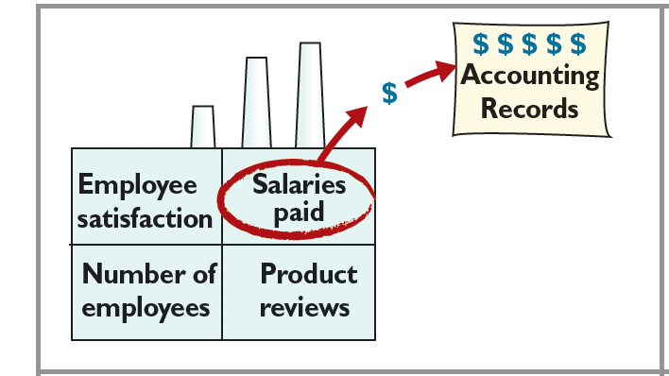
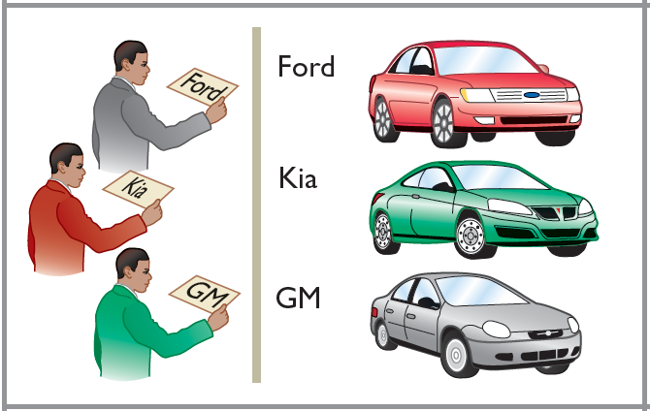
Assumptions in Financial Reporting Monetary unit and economic entity
Monetary Unit
Requires that only those things that can be expressed in money are included in the accounting records.
Economic Entity
States that every economic entity can be separately identified and accounted for.
LO 6

Slide 86
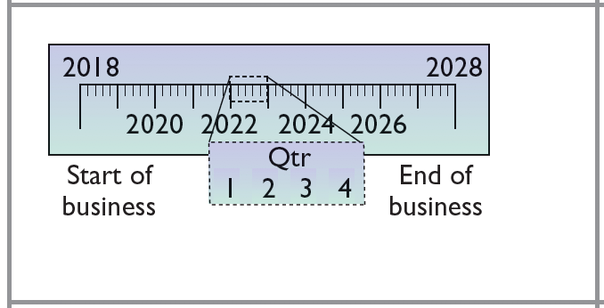

Assumptions in Financial Reporting Time period and going concern
Time Period
States that the life of a business can be divided into artificial time periods.
Going Concern
The business will remain in operation for the foreseeable future.
LO 6

Slide 87
Principles of Financial Reporting Historical cost and fair value
Historical Cost
Or cost principle, dictates that companies record assets at their cost.
Fair Value
Indicates that assets and liabilities should be reported at fair value (the price received to sell an asset or settle a liability).
LO 6

Slide 88
Principles of Financial Reporting Revenue recognition, expense recognition, and full disclosure
Revenue Recognition Principle
Requires that companies recognize revenue in the accounting period in which the performance obligation is satisfied.
Expense Recognition Principle
Dictates that efforts (expenses) be matched with results (revenues). Thus, expenses follow revenues.
Full Disclosure Principle
Requires that companies disclose all circumstances and events that would make a difference to financial statement users.
LO 6

Slide 89
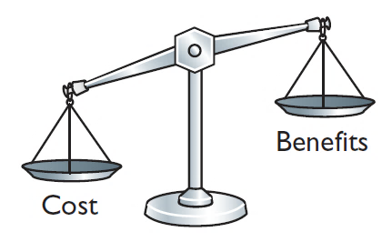
Cost Constraint
Cost Constraint
Accounting standard-setters weigh the cost that companies will incur to provide the information against the benefit that financial statement users will gain from having the information available.
LO 6

Slide 90
A Look at IFRS Similarities
LO 7 Compare the Procedures for Adjusting Entries Under
GAAP and IFRS
Key Points
Similarities
Companies applying IFRS also use accrual-basis accounting to ensure that they record transactions that change a company’s financial statements in the period in which events occur.
Similar to GAAP, cash-basis accounting is not in accordance with IFRS.
IFRS also divides the economic life of companies into artificial time periods. Under both GAAP and IFRS, this is referred to as the time period assumption.
LO 7

Slide 91
A Look at IFRS Similarities and Differences
Key Points
Similarities
The general revenue recognition principle required by GAAP that is used in this textbook is similar to that used under IFRS.
Revenue recognition fraud is a major issue in U.S. financial reporting. The same situation occurs in other countries, as evidenced by revenue recognition breakdowns at Dutch software company Baan NV, Japanese electronics giant NEC, and Dutch grocer Ahold NV.
Differences
Under IFRS, revaluation (using fair value) of items such as land and buildings is permitted. IFRS allows depreciation based on revaluation of assets, which is not permitted under GAAP.
LO 7

Slide 92
A Look at IFRS More Differences
Key Points
More Differences
The terminology used for revenues and gains, and expenses and losses, differs somewhat between IFRS and GAAP. For example, income under IFRS includes both revenues, which arise during the normal course of operating activities, and gains, which arise from activities outside of the normal sales of goods and services. The term “income” is not used this way under GAAP. Instead, under GAAP, income refers to the net difference between revenues and expenses.
Under IFRS, expenses include both those costs incurred in the normal course of operations as well as losses that are not part of normal operations. This is in contrast to GAAP, which defines each separately.
LO 7

Slide 93
A Look at IFRS Cash Versus Accrual Question
IFRS:
uses accrual accounting.
uses cash-basis accounting.
allows revenue to be recognized when a customer makes an order.
requires that revenue not be recognized until cash is received.
LO 7

Slide 94
A Look at IFRS Cash Versus Accrual Answer
I F R S:
Answer: uses accrual accounting.
uses cash-basis accounting.
allows revenue to be recognized when a customer makes an order.
requires that revenue not be recognized until cash is received.
LO 7

Slide 95
A Look at IFRS False Statement Question
IFRS Practice
Which of the following statements is false?
IFRS employs the time period assumption.
IFRS employs accrual accounting.
IFRS requires that revenues and costs must be capable of being measured reliably.
IFRS uses the cash basis of accounting.
LO 7

Slide 96
A Look at IFRS False Statement Answer
IFRS Practice
Which of the following statements is false?
IFRS employs the time period assumption.
IFRS employs accrual accounting.
IFRS requires that revenues and costs must be capable of being measured reliably.
Answer: IFRS uses the cash basis of accounting.
LO 7

Slide 97
A Look at IFRS Revenue Recognition Question
IFRS Practice
As a result of the revenue recognition project being undertaken by the FASB and IASB:
revenue recognition places more emphasis on when the performance obligation is satisfied.
revenue recognition places more emphasis on when revenue is realized.
revenue recognition places more emphasis on when expenses are incurred.
revenue is no longer recorded unless cash has been received.
LO 7

Slide 98
A Look at IFRS Revenue Recognition Answer
IFRS Practice
As a result of the revenue recognition project being undertaken by the FASB and IASB:
Answer: revenue recognition places more emphasis on when the performance obligation is satisfied.
revenue recognition places more emphasis on when revenue is realized.
revenue recognition places more emphasis on when expenses are incurred.
revenue is no longer recorded unless cash has been received.
LO 7

Slide 99
Copyright
©2020 John Wiley & Sons, Inc. All rights reserved.
No part of this publication may be reproduced, stored in a retrieval system, or transmitted, in any form or by any means, electronic, mechanical, photocopying, recording or otherwise, except as permitted by law. Advice on how to obtain permission to reuse this material is available at http://www.wiley.com/go/permissions.

